Slide 1
UNIT 5:
SYSTEM DYNAMICS AND SCRIPTING FUNDAMENTALS

Slide 2
UNIT DESCRIPTION
The focus of this unit of study is to introduce learners to the concepts of system thinking. Learners will begin to understand the interdependent elements of game design. Learners will also recognize the need for game documentation requirements and explore concepts in scripting.

Slide 3
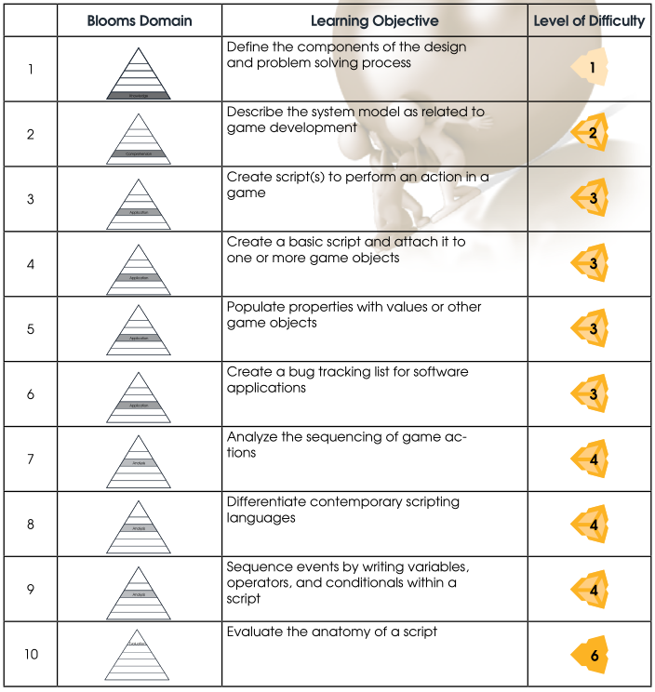

LEARNING OBJECTIVES
By the end of this unit, learners should be able to perform the following tasks:

Slide 4
COURSE OUTLINE

Slide 5

1. Components of a Game Design Document (GDD):
a. System Thinking and System Awareness
b. Design for Game Development
c. Establishing the Game Purpose
d. Identifying the Audience and Understanding the Player
e. Goals and Objectives for Games
f. Creating the Game Script and Narrative

Slide 6
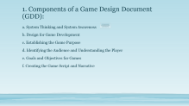
“So this is where we start with the systems thinking journey, it is to say how do I see the world? What is my set of assumptions, beliefs and values? And then to go out into the world and notice how the way that you see the world affects how you act in the world, the ways in which your worldview influences and decides what you are going pay attention to, and also decides what you're not going to pay attention to, thus shaping your perceptional all day every day”

Slide 7

2. System Thinking and Design
a. Using the Script and Storyboard
b. Sequences and Triggers
c. Flowcharting the Player Process
d. Creating a Complete Game Design Document (GDD)

Slide 8
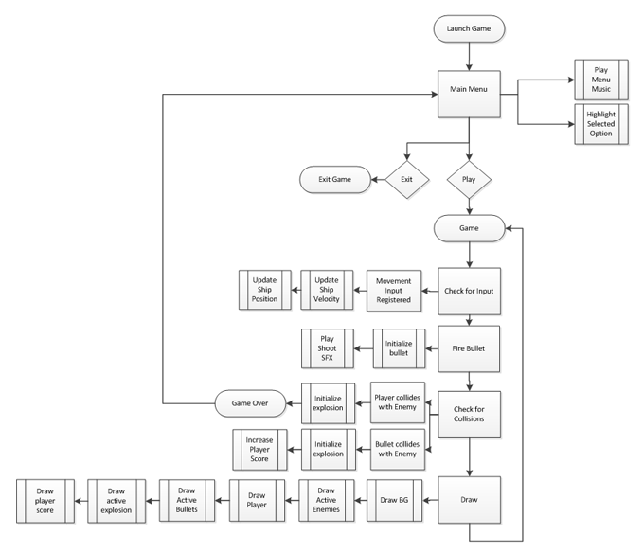

This is the flowchart for Shooter – it starts at the top with “Launch Game”, and follows all the way down through the various components the player can choose.

Slide 9
3. Languages
a. A comparison of programming languages
b. Choosing a language: programming versus scripting
c. Common languages: Strengths and Weaknesses

Slide 10
4. Anatomy of Creating Scripts:
a. Class
b. Declarations
c. Event Sequencing
d. Variables
e. Operators
f. Conditionals
g. Troubleshooting and bug tracking

Slide 11
Learner Scripting Skills - Assignment
This tutorial section covers the basic coding skills required to create a good game. By this Unit, learners should have experience in the import and setup of objects/models in the Unity Editor.
Now, they need to develop the skill of writing scripts that cause actions to occur in the game, beyond the basic functions. Learners should complete the following tutorials:
Spinning Cube: http://unity3d.com/learn/tutorials/modules/beginner/scripting/assignments/spinning-cube
Simple Clock: http://unity3d.com/learn/tutorials/modules/beginner/scripting/simple-clock

Slide 12
Building Learner Scripting Skills - Extended Assignment - 1
The tutorials listed below address basic commands within a game. In this assignment, learners will develop their skills and broaden their understanding of creating and writing scripts used to run and manage the games they create. Learners should complete the following tutorials:
Scripts as Behavior Components: http://unity3d.com/learn/tutorials/modules/beginner/scripting/scripts-as-behaviour-components
Variables and Functions: http://unity3d.com/learn/tutorials/modules/beginner/scripting/variables-and-functions
Conventions and Syntax: http://unity3d.com/learn/tutorials/modules/beginner/scripting/conventions-and-syntax

Slide 13
Building Learner Scripting Skills - Extended Assignment - 2
4. C# vs JS syntax: http://unity3d.com/learn/tutorials/modules/beginner/scripting/c-sharp-vs-javascript-syntax
5. IF statements: http://unity3d.com/learn/tutorials/modules/beginner/scripting/if-statements
6. Loops: http://unity3d.com/learn/tutorials/modules/beginner/scripting/loops
7. Classes: http://unity3d.com/learn/tutorials/modules/beginner/scripting/classes

Slide 14
Project Proposal for Capstone Project

Slide 15
SUGGESTED RESOURCES
Which books, digital resources, & other materials will be used in this lesson? Listed below is a recommendation of resources to consider for this unit:
Resource for Sample Flowchart and Game Design: http://xbox.create.msdn.com/en-US/education/tutorial/2dgame/design
Resource for Sample Flowchart and Game Design: Teach Games: Game design and development resources for educators: http://teachgames.wordpress.com/tag/flowchart/
The Ultimate Guide to Video Game Writing and Design, Dille, Flint
Writing for Video Game Genres: From FPS to RPG, Despain, Wendy
Video Game Design/Design: http://en.wikibooks.org/wiki/Video_Game_Design/Design
Resource for Additional Scripting Training
Great Resource for Quick Script/code Introduction: Unity Game Development in 24 Hours, Sams Teach Yourself: http://www.amazon.com/Unity-Development-Hours-Teach-Yourself/dp/0672336960, Mike Geig
Scripting: http://unity3d.com/learn/tutorials/modules/beginner/scripting
Learn C# scripting in Unity: http://www.catlikecoding.com/unity/tutorials/
Unity3Dstudent: http://www.unity3dstudent.com/tag/scripting/

